Slide 1
Commercial Application of Random Walks
GROUP 7

Slide 2
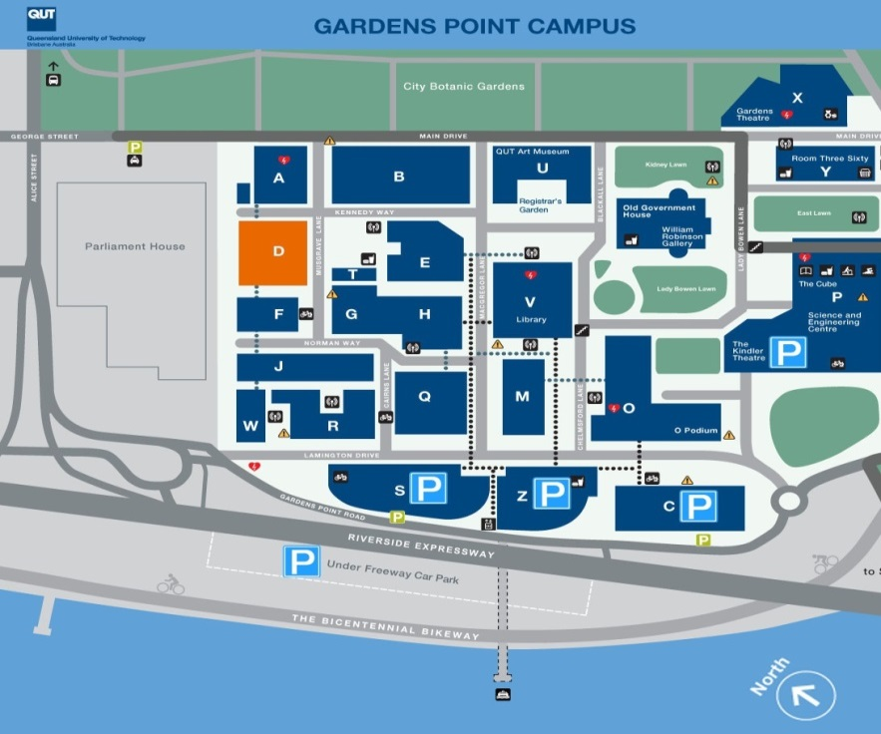
Our Idea
Simulate how people
move around QUT
Find ideal advertising location

Slide 3
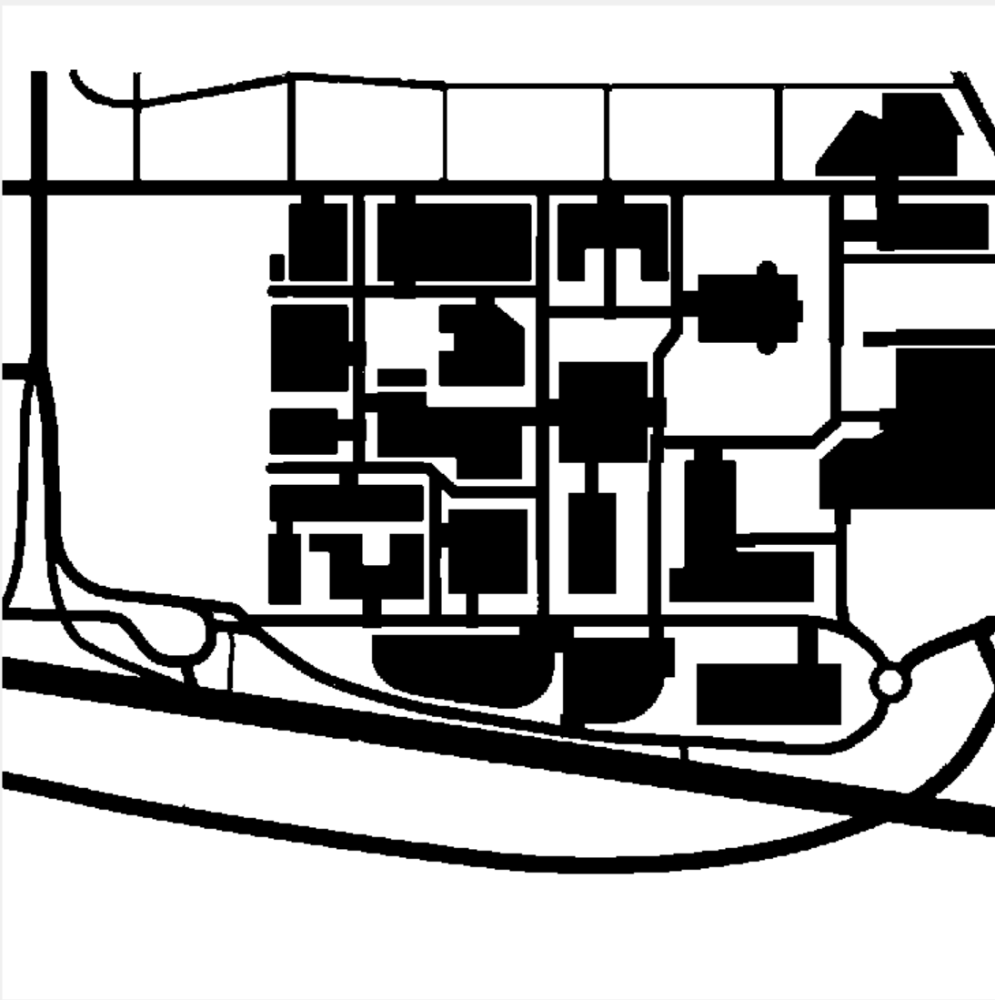



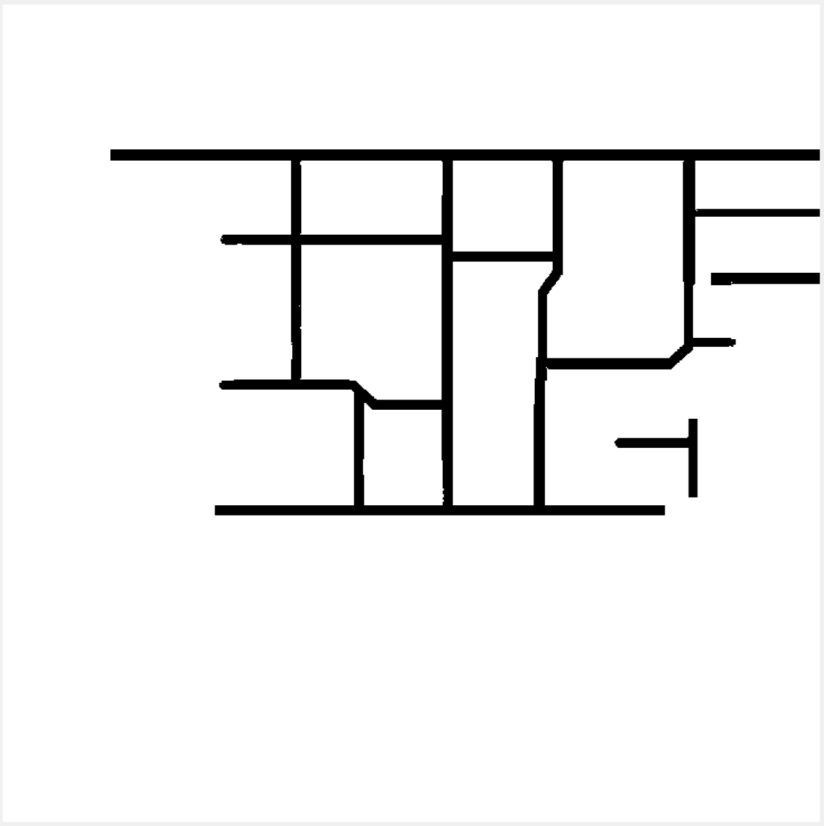



Slide 4
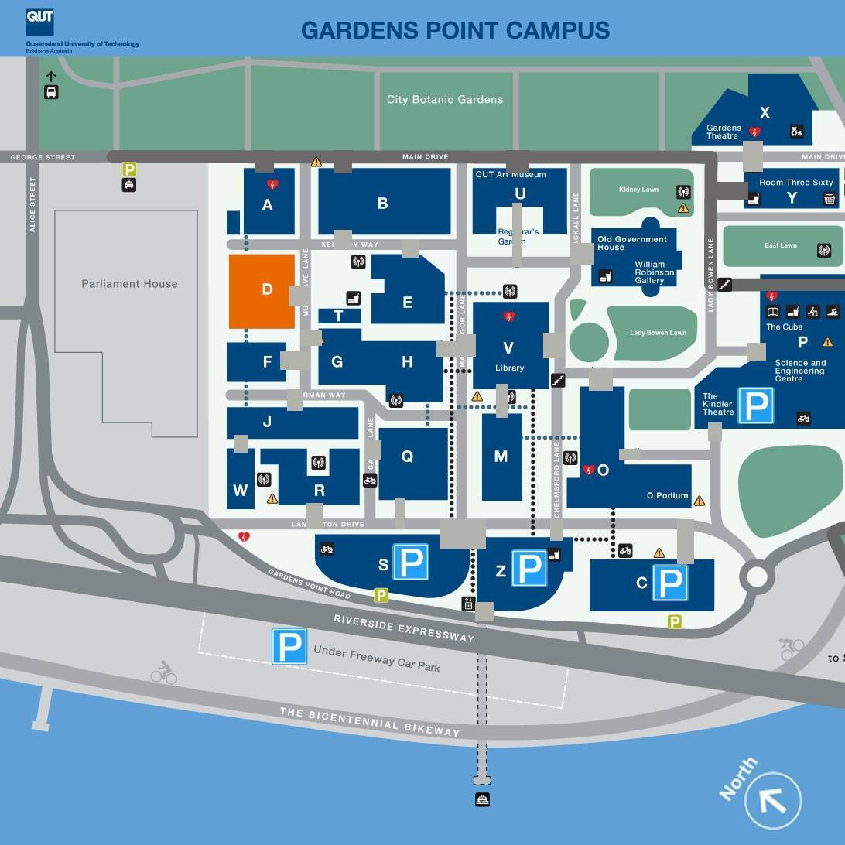

Slide 5
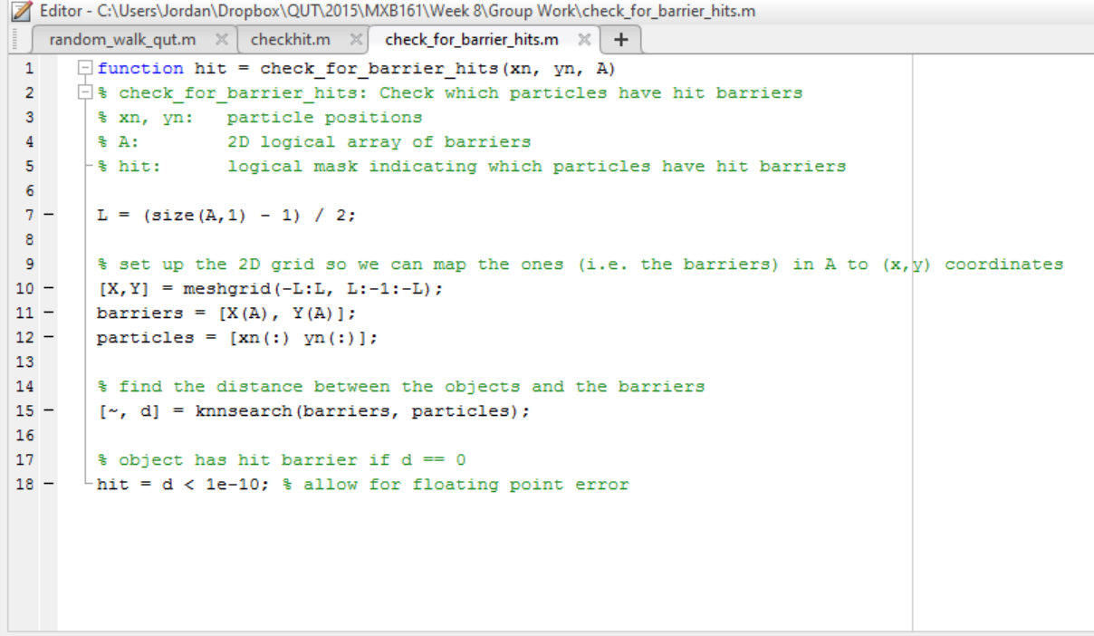

Slide 6
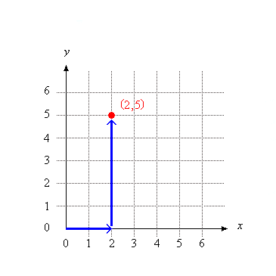
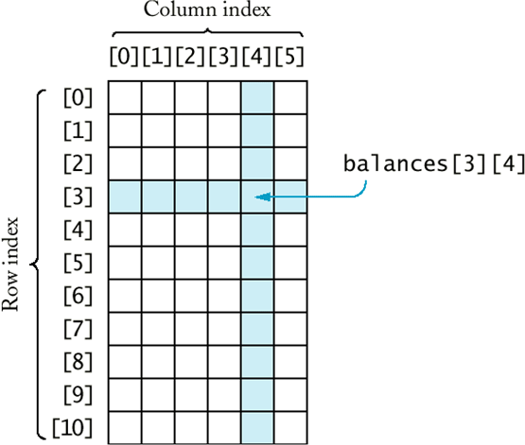
COMPARE
(x, y) Co - ordinates
(Rows, Columns) Array

Slide 7
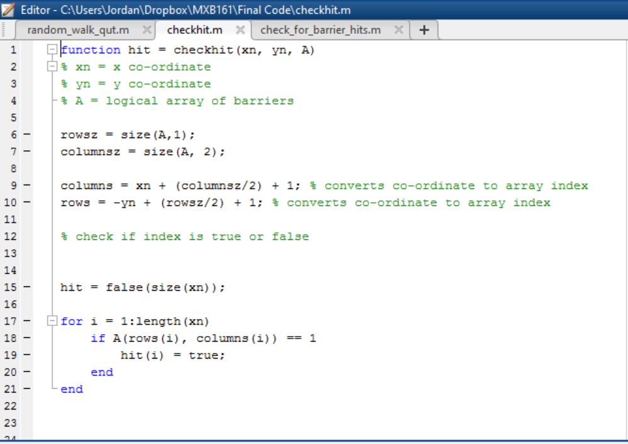

Slide 8
Limitations
Particles can’t go outside the mask: must stay within the width + height of the array
Particle co-ordinates + step size must be integers : you can’t have the 1.5th row, or 9.87th column.

Slide 9
Random Walks
Now that we have a map of QUT and people we need to simulate them moving about the university.

Slide 10
Idea
To change peoples ‘walking behaviour’ depending on their location to:
Make a more realistic simulation
To avoid people getting stuck

Slide 11
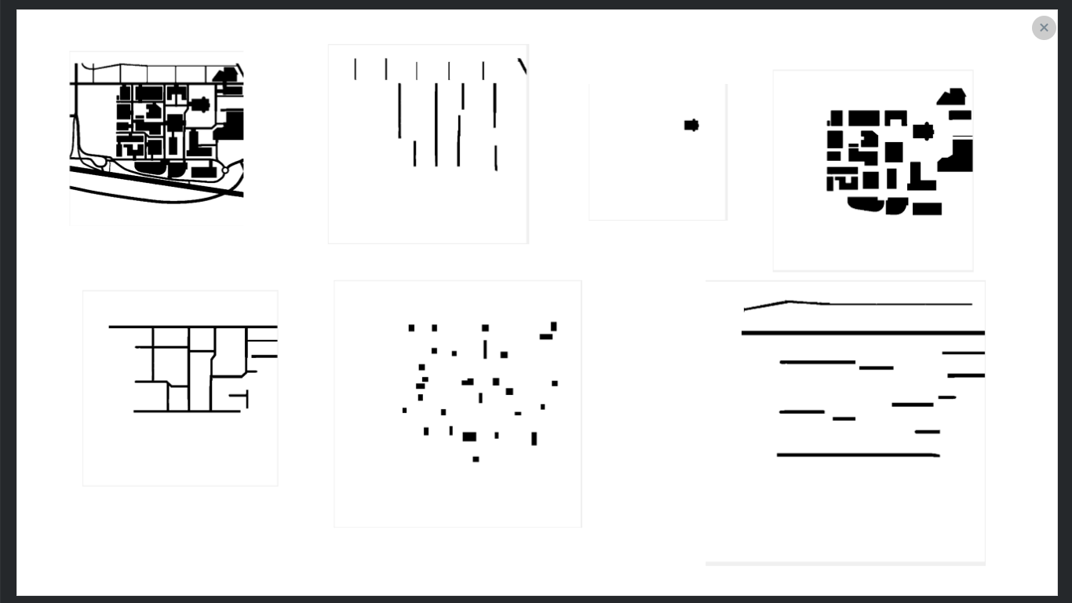
Buildings, Junctions & Doorways:
Up: 25%
Down: 25%
Left: 25%
Right: 25%
Horizontal Paths:
Up: 10%
Down: 10%
Left: 40%
Right: 40%
Vertical Paths:
Up: 40%
Down: 40%
Left: 10%
Right: 10%

Slide 12
How we did it
We learnt that by changing the parameters of each direction in the random walks we change the probability of the students movement
Using the hit masks that Jordan explained we put a condition on the probability

Slide 13
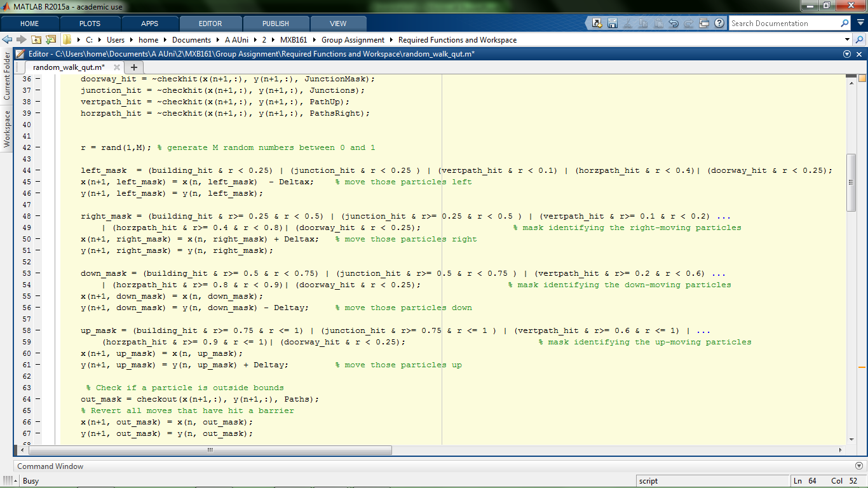
Modifications to the code

Slide 14
After the simulation has finished we used the animation code from the worksheets to show the ‘students’ moving
James will discuss how this data is displayed

Slide 15
Calculating the Population in Buildings
The aim of this simulation is to find the buildings which see the most traffic
How is it done?
The number of hits in each building is tallied.
This information is fed into:
An array which shows the final count at the end of the simulation.
A larger, separate array which stores the count at each step, them presented at the as an animated graph detailing the population counts in each building over time.

Slide 16
Explanation of the Code - Tally
The ‘tally’ function is called to sum the number of people in each building.
Two variable are made and assigned to be zero. ‘F’ is the ‘old’ count for the number of people in a building, and ‘S’ is the ‘new’ count.
The values are compared for each n. If the new value is smaller the ‘old’ value is updated. If the ‘new’ value is bigger, then the difference between the two is added to and ongoing sum and then F is again updated.

Slide 17
Explanation of the Code - Animated Graph
The ‘live_hist’ function is called to plot the animated graph.
The ‘S’ array (all of the building populations for each step) is transposed and then fed into the ‘bar’ command. (To make a bar graph).
Axis are set and named, as well as allocating an animating title.
The whole process repeats for each of the steps in the simulation.

Slide 18
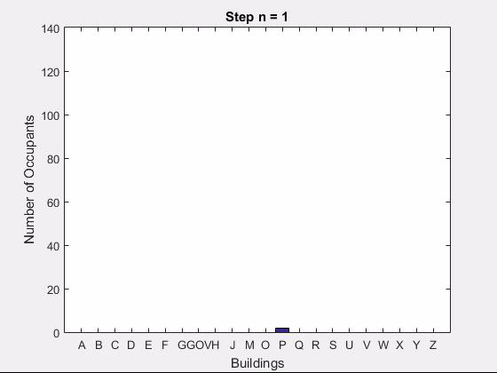
1000 Steps Histogram

Slide 19
Results
As shown clearly in the graph and final data, ‘P Block’ is by far the most visited building at QUT Gardens Point.
This result is roughly the same for every test that is run, so the simulation is quite repeatable.
There may be some differences between what is seen in this simulation and your own experience of pedestrian traffic around QUT.

Slide 20
Assumptions and Limitations
Time consuming to create masks
Buildings are only one storey
Bigger buildings having greater random traffic
Random walk appropriately models people
Model can't be excessive in size (dimensions or no. of particles)

